Slide 1

Customer Driven Development
Framework to Link Customer Needs to….
  Marketing Specs to…
  Engineering Specs to…
  Test Case Preparation…
  Customer Satisfaction Metrics
Notes:
A note for instructors about the format of the instructor materials:
The following materials are for the use of the instructor in teaching the RMUC course. Each instructor needs to decide how to use the slides to best fit his or her teaching style.
Many slides are accompanied by instructor notes and/or by student notes. The instructor notes on a slide give suggestions to the instructor about how to present the information on the slide, particular points to emphasize, and background information. The student notes on a slide give more detail and additional information about the topic of the slide.
Instructors should be familiar with the student notes in addition to the instructor notes because the student notes contain detail that the instructor may need to mention. The instructor should NOT expect or encourage students to read the student notes during the class itself.
Suggestions for introductions are given on the following slide.

Slide 2
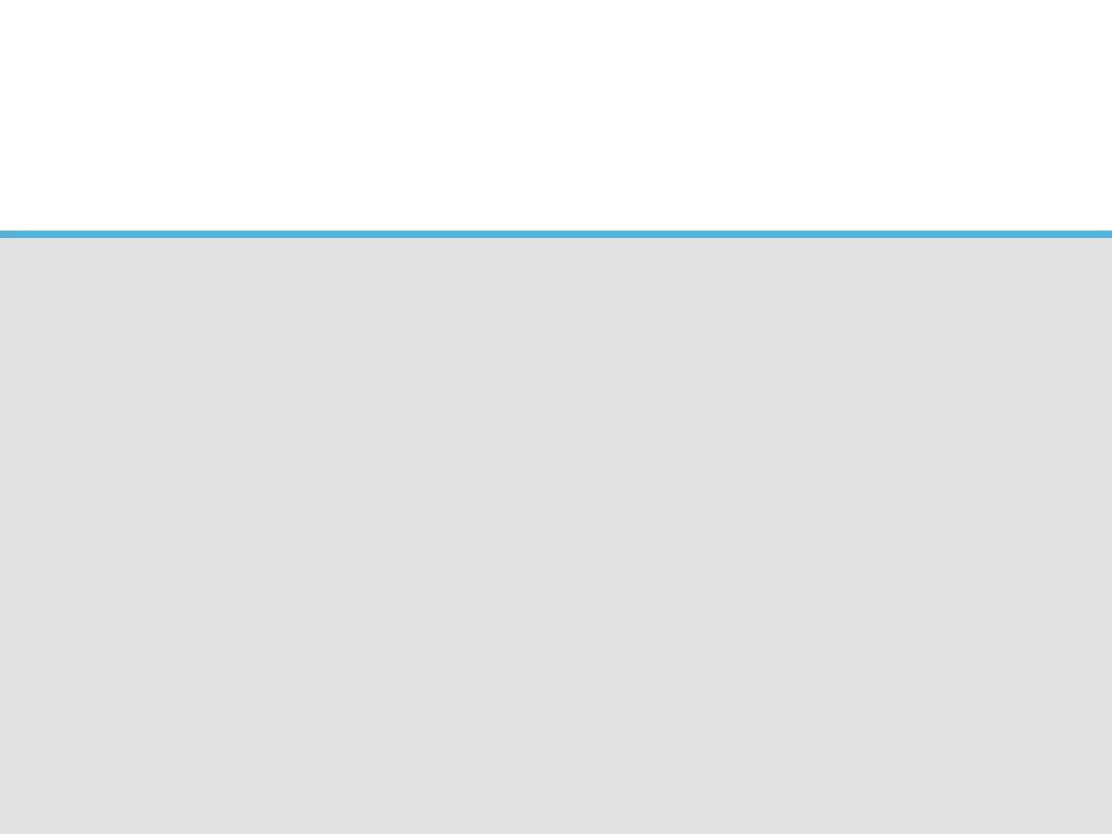
Introducing
Requirements Engineering

Slide 3

Challenges of Requirements Mgmt
Use consistent document formatting for capturing requirements
Use consistent techniques for requirements management
Use the proper techniques for each type of requirement

Slide 4
Addressing the Challenges
Involve the users (speak their language)
Use checklists and traceability matrices to ensure completeness
Link requirements upstream & downstream

Slide 5
Types of Customers
Customers who purchase products & services to get a job done
Partners who provide products or services that we use to build products and/or deliver services
Distributors who purchase our products and resell them to customers
Patients who consume our products
Regulatory bodies who require compliance
Business Units are customers of the Functional Departments
Functional Departments are customers of each other

Slide 6
Requirements Overview
Requirements are statements of desired outcomes by customers along with metrics for success
Jobs are processes which are composed of:
  Inputs
  Discrete process steps, business rules & data
  Outputs
The desired outcomes represent the changes to:
  Our services (process changes)
  Our products & systems (Features that we need to add/change/remove)
The metrics for success are used to determine how much change is required to deliver the desired outcomes for the customers.

Slide 7
Documenting Customer Outcomes
Use Cases can be used to document the jobs customers are doing, their desired outcomes and the metrics they provide for defining success for each outcome.
Use Cases can be captured in Word documents or (better) using an enterprise modeling tool. A Use Case contains:
  Desired Outcomes & Metrics (for each outcome)
  Storyboard (actors and jobs they are performing)
  Process Flows (SIPIC models are very helpful here)
  Data Elements
  Business Rules & Constraints

Slide 8
Documenting Engineering Requirements
Once the requirements are documented, we need to translate the customer view of the requirements into an engineer’s view of what changes need to be incorporated into existing products and/or systems.
The Use Cases provide business / systems analysts with the baseline to derive the list of Functional & Non-Functional Features that are used to guide engineers in their designs and testing for implementing changes to products and systems.

Slide 9
Applying Requirements Engineering to our Development Lifecycle

Slide 10
Step 1: Document Customer Outcomes
Customers perform jobs to get things done. We first need to document the issues that are impacting their jobs and determine where the gaps exist in the products and/or services that we offer.
  Scenario: Survey of external customers reveals issues with their ability to find the right products that meet their needs and place orders for those products.
  Marketing responds by documenting the desired outcomes that the customers (say Doctors & Nurses) are performing, where they are relying on our products / services*.
  * In this case, they are relying on our customer portal.

Slide 11
Step 1: Document Desired Outcomes
Job | Desired Outcome | Metrics for success | Constraints
Find products that can improve medication delivery for acute care patients | Minimize the time it takes to find products | 2-3 minutes turnaround
 | Increase the ability for a customer to find the right product | Eliminate the need for guesswork, training and/or calls to the help desk. Should be intuitive.
 | Minimize the effort required to conduct future product searches | Remember my profile information so I don’t have to start searches from scratch. (more of an Amazon experience) | Capturing profile information will require upfront legal approvals
Order a solution that will reduce medical errors while streamlining medication delivery | Minimize the effort required to order the right set / bundle of products and services to address my needs | Create product & service bundles designed to address problem scenarios that are common in hospitals. | We currently don’t have these problems well documented
 | Minimize the number of screens and decisions the customer needs to make. | Reduce the number of decisions to 3-5 for the customer (down from the 10-12 currently) | May require a new technology investment
 | Increase the usability of the ordering process by creating an interactive solution that guides me to purchase “just what I need” not “just in case”. | Optimize the deal for the customer so they only order the products and services they need. | Ditto above
 | Minimize the need to contact supplier for status on my order. | Provide automated alerts as to the status of the order (like the UPS experience via the tracking number) | Don’t have insights on value chain processes

Slide 12
Step 2: Working with Use Cases
Use Cases contain the following artifacts:
  Storyboard (shows the actors involved in performing a job)
  SIPOC (useful tool for decomposing the processes used to perform a job)
  Process Model (formalized representation of the discrete processes and their relationships to other processes, data and business rules)
  Data Elements (identifies the data upon which the processes rely to produce outputs / deliverables)
  Business Rules & Constraints (controls the behavior of the processes by acting on metadata and/or triggered events)
  Features (the functional capabilities required to achieve the desired outcomes for a job performed by the cust.)

Slide 13
Step 3: Adopting Feature Driven Dev (FDD)
All Functional Features for products and systems are built upon Non-Functional Features.
Feature Oriented Domain Analysis (FODA) is used to decompose Functional Features (what customers want) into Sub-Features and Non-Functional Features (what engineers want).
Feature Driven Development focuses engineers on deriving their technical designs for building products and/or systems from Non-Functional Features.
Success criteria for Testing the Non-Functional Features is also derived from the metrics associated with Functional Features – found in the Use Cases.

Slide 14
Step 3: Adopting Feature Driven Dev (FDD)
Traceability is THE key to successful FDD. We can accomplish this using a repository to capture requirements data and metadata. The schema would minimally contain the following data elements:
  Feature Number (key)
  Business Domain (see Appendix A)
  Architecture Domain (see Appendix B)
  Feature Type (Functional or Non-Functional)
  Priority (High, Medium, Low)
  Name
  Description
  Success Criteria (derived from Use Case)
  Use Case Number (alternate key)
  Dependencies (on other Functional & Non-Functional Features)

Slide 15
Step 3: Adopting Feature Driven Dev (FDD)
The schema for capturing the requirements also provides a valuable tool for managing the execution of the development lifecycle. We call this tool the Traceability Matrix. We’ll show how this is used to guide & control quality throughout the remaining stage gates in the SDLC in the following slides.

Slide 16
Step 4: Incorporating FDD into HLD
The first step in preparing the High Level Design (HLD) is to carve out the Non-Functional Features from the Requirements database and create a subset of the Traceability Matrix (TM).
This TM subset will be used to cross-reference the key design elements in the HLD to identify how the design will address all of the Non-Functional Features.
The designer will also need to identify the success criteria for each Non-Functional Feature in the TM subset. This criteria will provide the pass/fail metrics for System & Integration Testing.

Slide 17
Step 4: Incorporating FDD into HLD
If the designer identifies is not able to address any of the Non-Functional Features with the available tools (within our architecture standards), then he/she needs to document the GAP and present options for consideration to the ARB for review.
Separately, the ARB may also elect to review the HLD for adherence to the Architecture Principles and “ilities” to ensure we leverage technology in the best manner.

Slide 18
Step 5: Incorporating FDD into LLD
A Low Level Design (LLD) should (ideally) be created for all large components and/or separate system identified in the HLD. Each LLD will carve out a subset* of the Non-Functional Features in the TM from the HLD.
The same level of rigor for mapping features to the functionality and success criteria should be carried over from the HLD. However, the success criteria for each Non-Functional Feature in the LLD will be used for pass/fail in Unit Testing.
  * Note: It may be necessary to address the same Non-Functional Feature with more than one LLD.

Slide 19
Step 5: Incorporating FDD into LLD
The LLD should cover the following details associated with each Non-Functional Feature:
  Functionality (pseudo code that addresses the discrete process steps, data elements, metadata and business rules originally documented in the process model from the Use Cases).

Slide 20
Quality: Ensuring Quality throughout DLC
In order to ensure that the deliverables covering requirements through the development lifecycle are of high quality, we will introduce a formal inspection process to compliment the testing of product / system components.
The inspection process will be used to identify Major Defects in artifacts mentioned in the prior slides (Customer Outcomes, Use Cases, Requirements Repository, Traceability Matrix, HLD, LLD).
These defects will be tracked in the same Defect Mgmt System used to track defects found in Testing.

Slide 21
Quality: Test Planning throughout DLC
Test planning (test cases, test data & success criteria) will need to be created for each Feature (Functional & Non-Functional and all levels of granularity – a.k.a. sub-features):
  User Acceptance Testing
    Built using the Functional Features derived from Business Outcomes & Use Cases
  System & Integration Testing
    Built using the Non-Functional Features derived from HLD
  Unit Testing
    Built using the Non-Functional Features derived from LLDs

Slide 22
Quality: Measuring Customer Satisfaction
Now that we’re able to capture the success criteria for each desired outcome for customers, we can revisit the customers to assess their satisfaction with the improved products and services that we have moved into production.
Success is measured by our ability to:
  Quality: Meet our commitments (address the desired outcomes designated as the highest priority)
  Speed & Cost: Address the customer’s request within the projected timelines and budget

Slide 23
Appendices

Slide 24
Appendix A: Business Domains
Finance
Information Technology
Operations
Commercial
Human Resources
Legal
Research & Development
Public Affairs
Office of Ethics & Compliance
Quality

Slide 25
Appendix B: Architecture Domains
Business Architecture
Technical Architecture
Information Architecture
Application Architecture
Operational Architecture
Implementation Architecture

